Slide 1
HEART DISEASES PREDICTION
MAJOR PROJECT(research based)
Project ID: CSE-I-05

Slide 2
Author details
TEAM ID: CSE-I-05
Manak (06114802718)
Manaswi (06214802718)
Pankaj Kumar (07414802718)
Ms. Garima Gupta

Slide 3
Abstract
The contemporary evolution in healthcare technologies plays a considerable and significant role to improve medical services and save human lives. Heart disease or cardiovascular disease is the most fatal and complex disease which it is hardly to be detected through our naked eyes, as numerous people have been suffering from this disease globally. Heart attacks occur when the ranges of vital signs such as blood pressure, pulse rate, and body temperature exceed their normal values. Therefore, machine learning-based techniques are used for the diagnosis with higher accuracy, using datasets compiled from former medical patients’ reports.

Slide 4
Introduction
It is difficult to identify heart diseases because of several contributory risk factors such as diabetes, high blood pressure, high cholesterol etc.
The diagnosis of heart disease is a challenging task, which can offer automated prediction about heart condition of patient so that further treatment can be made effective.
The diagnosis of heart disease is usually based on signs and symptoms of the patient.
The severity of heart disease is classified based on various classification algorithms like K-nearest neighbour algorithm(KNN), Decision Trees (DT), Naïve Bayes (NB) etc.

Slide 5
Motivation
A major challenge facing healthcare organization is the provision of quality services at affordable cost.
Quality service implies diagnosing patients correctly and administering treatments that are effective.
Poor clinical decisions can lead to disastrous consequences.
Hospitals must also minimize the cost of clinical tests.

Slide 6
Technology Stack
Python
Numpy
Pandas
Matplotlib
Seaborn
Sklearn
Keras

Slide 7
Algorithms
Logistic regression :
Logistic regression is one of the most popular Machine Learning algorithms, which comes under the Supervised Learning technique. It is used for predicting the categorical dependent variable using a given set of independent variables.
Naïve Bayes
Naïve Bayes methods are a set of supervised learning algorithms based on applying Bayes’ theorem with a strong assumption that all the predictors are independent to each other i.e. the presence of a feature in a class is independent to the presence of any other feature in the same class.

Slide 8
Algorithms
Support vector machines (SVMs) :
Support vector machines (SVMs) are powerful yet flexible supervised machine learning algorithms which are used both for classification and regression. But generally, they are used in classification problems.
K-nearest neighbours (KNN):
K-nearest neighbors (KNN) algorithm is a type of supervised ML algorithm which can be used for both classification as well as regression predictive problems. However, it is mainly used for classification predictive problems in industry.

Slide 9
Algorithms
Neural network:
Neural networks are parallel computing devices, which are basically an attempt to make a computer model of the brain.
Decision Tree:
Decision tree analysis is a predictive modelling tool that can be applied across many areas.
Random Forest:
Random forest is a supervised learning algorithm which is used for both classification as well as regression. But however, it is mainly used for classification problems.

Slide 10
Algorithms
Soft Voting:
In soft voting, every individual classifier provides a probability value that a specific data point belongs to a particular target class. The predictions are weighted by the classifier's importance and summed up. Then the target label with the greatest sum of weighted probabilities wins the vote.

Slide 11
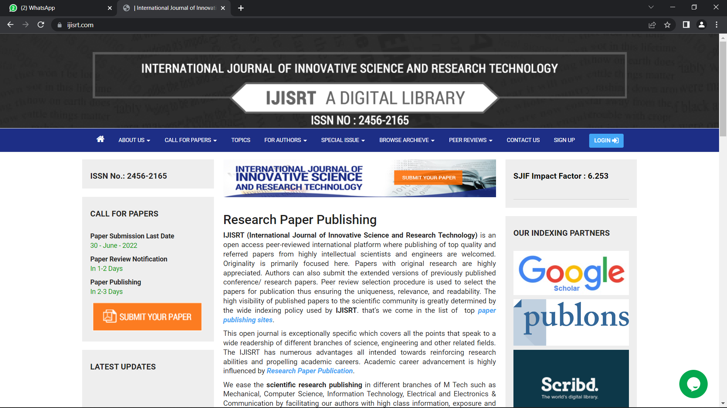
Research paper publication

Slide 12
References
Mostafa A, Xiao-Yan G, Amin Ali, Hassan S, Eman M., (2021), Improving the Accuracy for Analyzing Heart Diseases Prediction Based on the Ensemble Method, 6663455, 2021/02/10, 1076-2787, https://doi.org/10.1155/2021/6663455, Hindawi
Enriko I. K. A., Muhammad, Suryanegara. and Dadang, Gunawan. (2016). Heart Disease Prediction System using k-Nearest Neighbor Algorithm with Simplified Patient's Health Parameters. Journal of Telecommunication, Electronic and Computer Engineering, 8(12), 59-65.
Boshra, Bahrami., Mirsaeid, Hosseini, Shirvani. (2015). Prediction and Diagnosis of Heart Disease by Data Mining Techniques. Journal of Multidisciplinary Engineering Science and Technology, 2(2), 164-168.
Janardhanan, P., L, Heena. and Sabika, F. (2015). Effectiveness of Support Vector Machines in Medical Data Mining. Journal of Communications Software and Systems, 11(1), 25-30.

Slide 13
Thank you!

